Slide 1
Queues

Slide 2
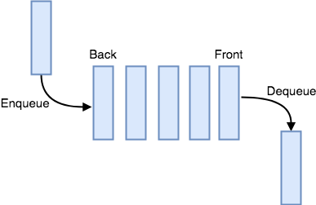
Queue
Ordered list of elements in which we
Add elements only at one end, called Rear end of the queue
Delete elements only at the other end, called Front end of the queue.

Slide 3
Queue Example
Accessing printer in multiuser environment-
If a printer is in process and more than one user wants to access the printer then
it maintains the queue for user requesting access and serves in FIFO manner for giving access.

Slide 4

Queue
Our software queues have counterparts in real world queues.
We wait in
queues to buy pizza,
to enter movie theaters,
to drive on a turnpike, and
to ride on a roller coaster.

Slide 5
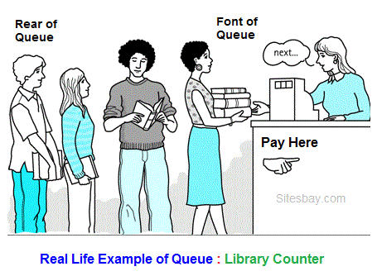
Queue
Library Counter is another best Real Life Example of Queue; here first person visits first on counter for issuing book and exit first.
A common example of queue is movie theatre ticket counter,
the first person who stand in front of ticket window take ticket first and remove from line and
new person always stand in line from end.

Slide 6
Typical uses of queues are in simulations and operating systems
Ready Queue:-Operating systems often maintain a queue of processes that are ready to execute or that are waiting for a particular event to occur.
Buffer:-Computer systems must often provide a “holding area” for messages between two internal processes or programs, or between two systems over a network.
This holding area is usually called a “buffer” and is often implemented as a queue, because we want the message time order to be retained.

Slide 7
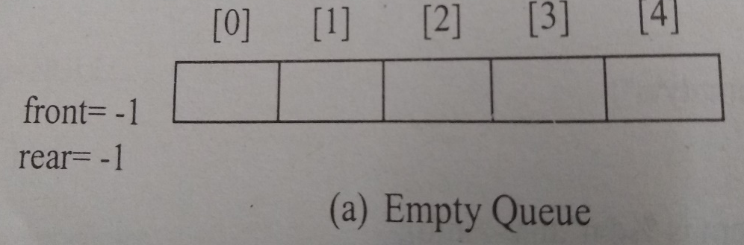
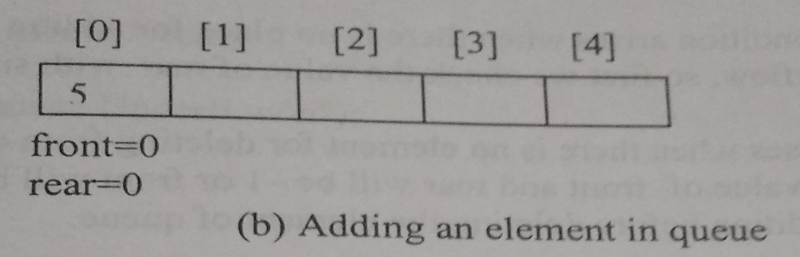
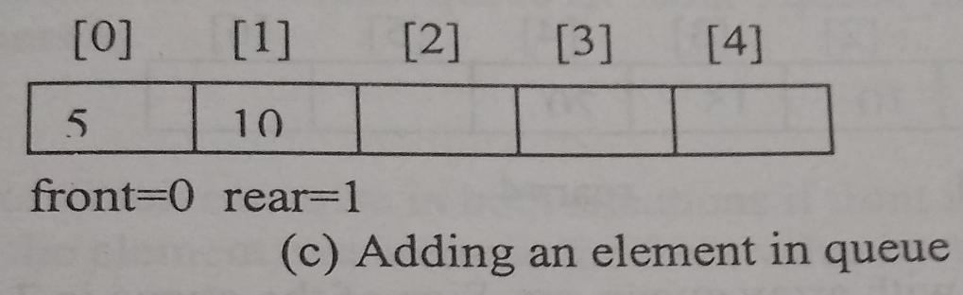
Working of Queue
Initially Queue is empty
Adding 1st element, both front and rear pointing to the First element
Adding 2nd element,
Rear gets incremented,
Insertion takes place at rear end.

Slide 8
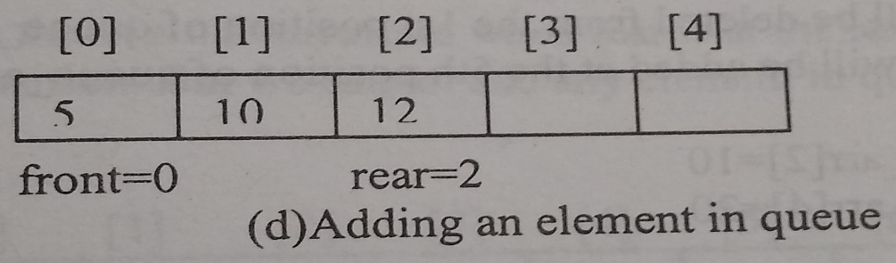
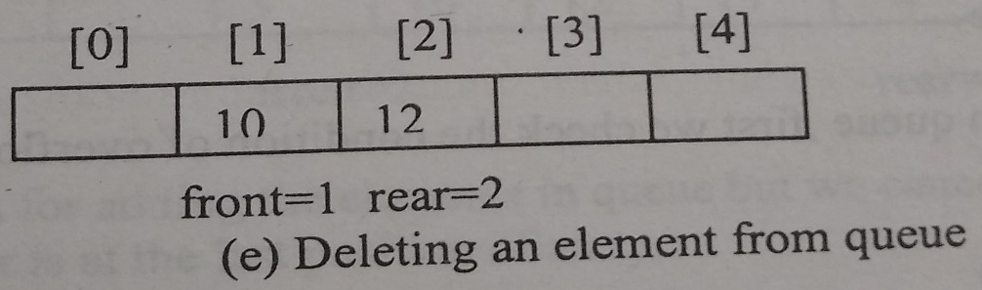
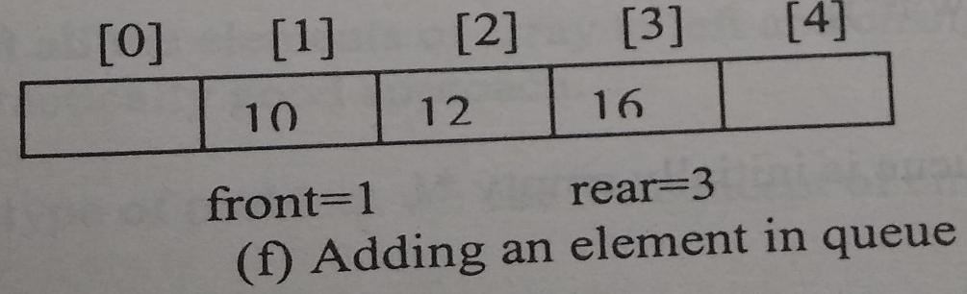
Working of Queue
Adding 3rd element, Rear gets incremented, As Insertion takes place at rear end.
Deleting an element,
Deletion takes place at Front end.
Front gets incremented,
Adding other element, Rear gets incremented, As Insertion takes place at rear end.

Slide 9
Working of Queue
Delete 10
Delete 12
Delete 16

Slide 10
Array Representation of Queue

Slide 11
Queue Implementation using Arrays
Two Variables Needed-
Rear
Keeps the status of Last element added in the queue
Front
Keeps the status of First element of the queue

Slide 12
Conditions-
Queue Overflow condition,
There is no place for adding elements in queue.
So need to check the Value of rear with the size of array
if (rear==MAX-1)
{
printf("Queue Overflow\n")
}

Slide 13
Conditions-
Queue Underflow condition,
If there is no element in queue.
Either:
The value of front and rear will be -1 or
Front will be greater than rear.
if (front == -1 || front > rear)
{
printf("Queue Underflow\n");
return ;
}

Slide 14
Queue Implementation using Arrays
#define MAX 5
int queue_arr[MAX];
int rear = -1;
int front = -1;

Slide 15
Insert Operation
insert()
{
int added_item;
if (rear==MAX-1)
printf("Queue Overflow\n");
else
{
if (front==-1) /*If queue is initially empty */
front=0;
printf("Input the element for adding in queue : ");
scanf("%d", &added_item);
rear=rear+1;
queue_arr[rear] = added_item ;
}
}/*End of insert()*/
Rear gets incremented,
Insertion takes place at rear end.

Slide 16
Delete Operation
del()
{
if (front == -1 || front > rear)
{
printf("Queue Underflow\n");
return ;
}
else
{
printf("Element deleted from queue is : %d\n", queue_arr[front]);
front=front+1;
}
}/*End of del() */
Deletion takes place at Front end.
Front gets incremented,

Slide 17
Display Operation
display()
{
int i;
if (front == -1)
printf("Queue is empty\n");
else
{
printf("Queue is :\n");
for(i=front; i<= rear; i++)
printf("%d ",queue_arr[i]);
printf("\n");
}
}/*End of display() */

Slide 18
Problem-
A situation arises when
rear is at the last position of array and
front is not at the 0th position.

Slide 19
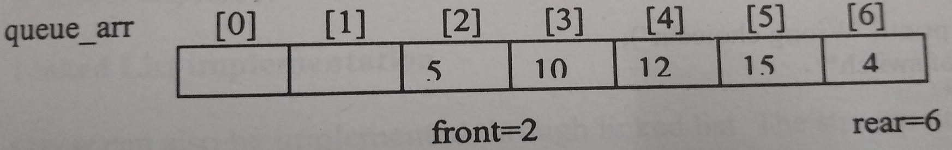
Problem-
A situation arises when
rear is at the last position of array and
front is not at the 0th position.

Slide 20
Problem-
There are 2 spaces for adding elements in queue
But we cannot add element any element in queue because rear is at the n-1th position/last position of the array.

Slide 21
Solution-
Ist Approach
Shift all elements of array to left and change the position of front and rear but it is not practically good approach

Slide 22
Solution-
Other approach-
Use the concept of Circular queue

Slide 23
ISRO | ISRO CS 2017 | Question 53
The minimum number of stacks needed to implement a queue is (A) 3 (B) 1 (C) 2 (D) 4

Slide 24
ISRO | ISRO CS 2017 | Question 53
The minimum number of stacks needed to implement a queue is (A) 3 (B) 1 (C) 2 (D) 4

Slide 25
ISRO | ISRO CS 2017 | Question 53
The minimum number of stacks needed to implement a queue is (A) 3 (B) 1 (C) 2 (D) 4 Answer: (C)
Keep 2 stacks, let's call them inbox and outbox.
Enqueue:
Push the new element onto inbox
Dequeue:
If outbox is empty, refill it by popping each element from inbox and pushing it onto outbox
Pop and return the top element from outbox

Slide 26
Linked List Representation of Queues

Slide 27
Linked List Representation of Queues
Queue can also be implemented through linked list.
The structure of the node will be as:
struct node
{
int data;
struct node*link;
}

Slide 28
Queue Implementation using Singly Linked List
Two Pointers Needed-
Front
Will point to the 1st node of the linked list
Rear
Will point to the last node of linked list

Slide 29
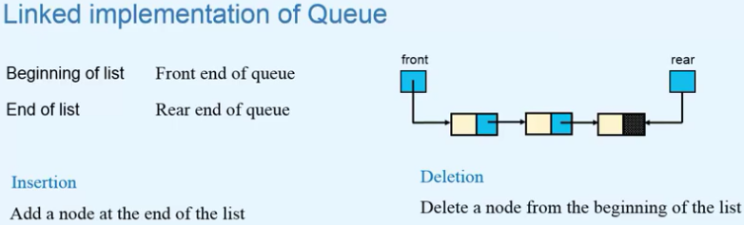

Slide 30
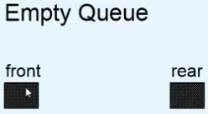
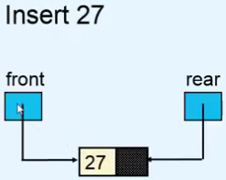
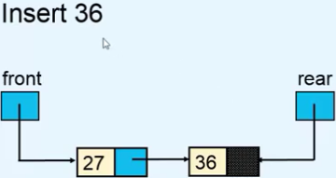
Working of Queues

Slide 31
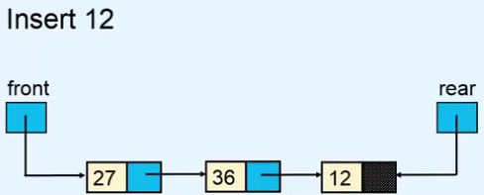
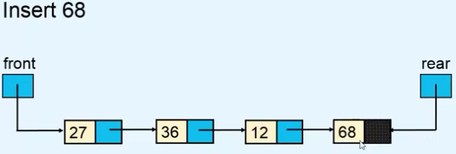
Working of Queues

Slide 32
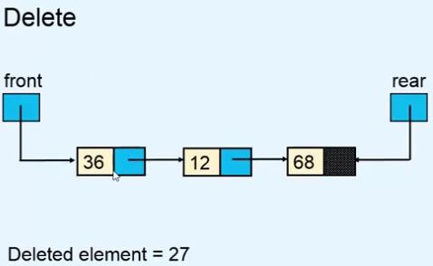
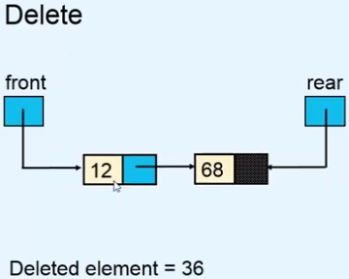
Working of Queues

Slide 33
Insert Operation
For Insertion in Queue,
We add element at the end of the linked list.

Slide 34
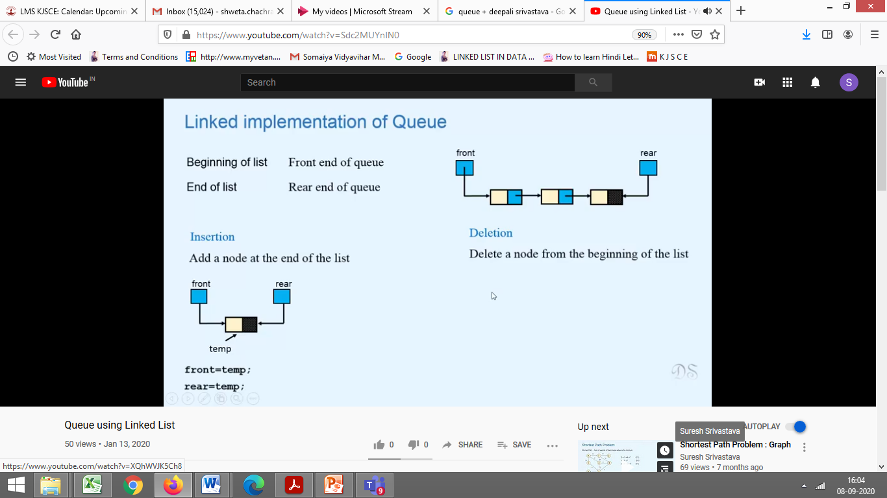
Insert Operation
If the linked list is empty,
front=NULL
rear=NULL
After insertion, Both rear and front will point to the newly inserted node

Slide 35
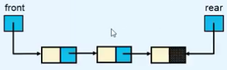
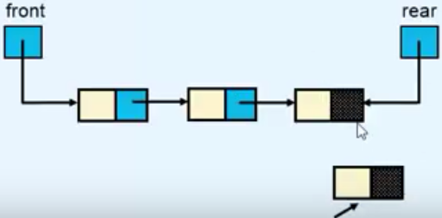
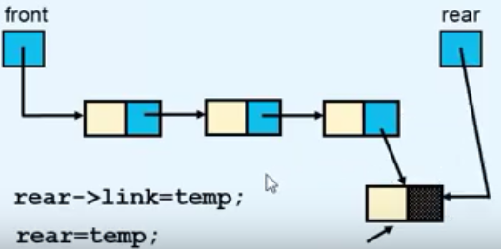
Insert Operation
If the linked list is not empty,
Rear will point to the newly inserted node
temp
temp

Slide 36
Insert Operation
insert()
{
struct node *tmp;
int added_item;
tmp = (struct node *)malloc(sizeof(struct node));
printf("Input the element for adding in queue : ");
scanf("%d",&added_item);
tmp->info = added_item;
tmp->link=NULL;
if(front==NULL) /*If Queue is empty*/
front=tmp;
rear=tmp;
else
rear->link=tmp;
rear=tmp;
}/*End of insert()*/

Slide 37
Delete Operation
For Deletion in Queue,
We delete the first node of the linked list

Slide 38

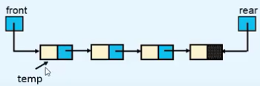
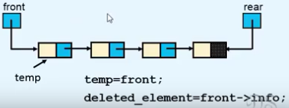
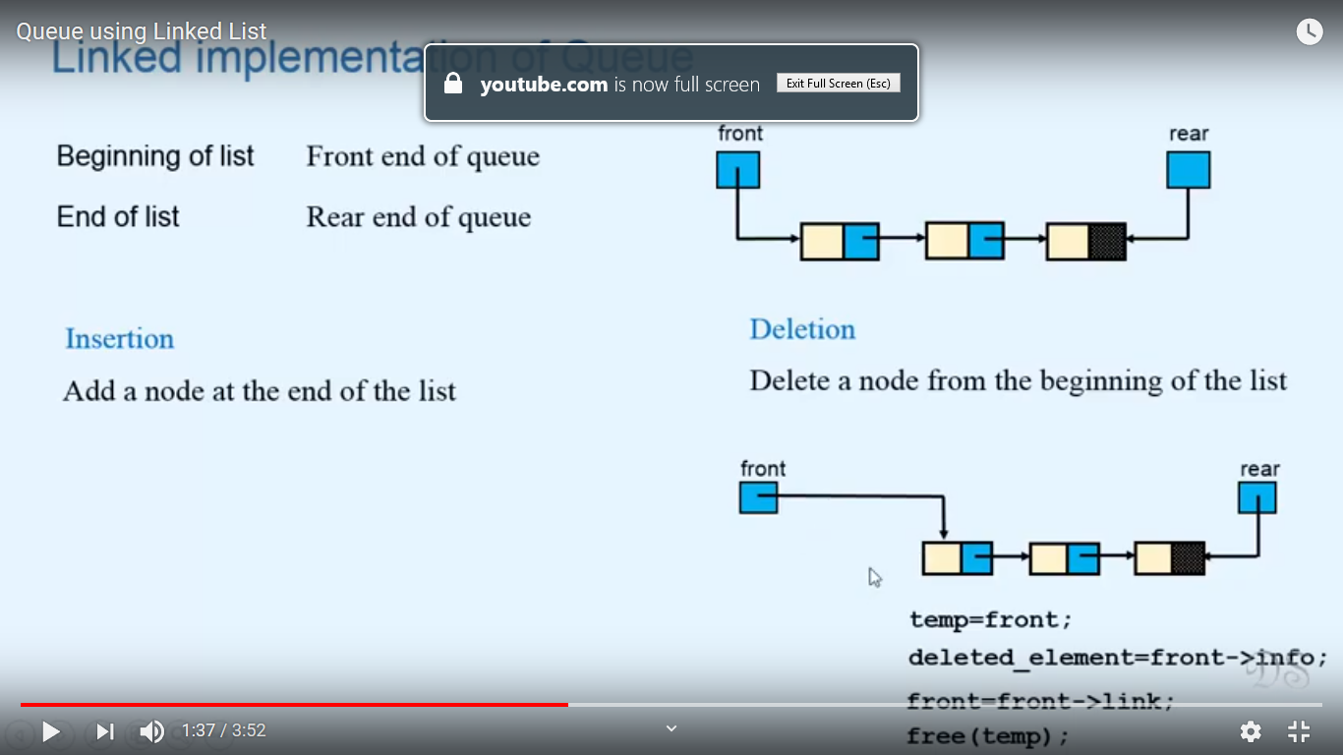
Deletion Operation

Slide 39
Delete Operation
del()
{
struct node *tmp;
if(front == NULL)
printf("Queue Underflow\n");
else
{
tmp=front;
printf("Deleted element is %d\n",tmp->info);
front=front->link;
free(tmp);
}
}/*End of del()*/

Slide 40
Display Operation
display()
{
struct node *ptr;
ptr = front;
if(front == NULL)
printf("Queue is empty\n");
else
{
printf("Queue elements :\n");
while(ptr != NULL)
{
printf("%d ",ptr->info);
ptr = ptr->link;
}
printf("\n");
}/*End of else*/
}/*End of display()*/

Slide 41
Circular Queue

Slide 42
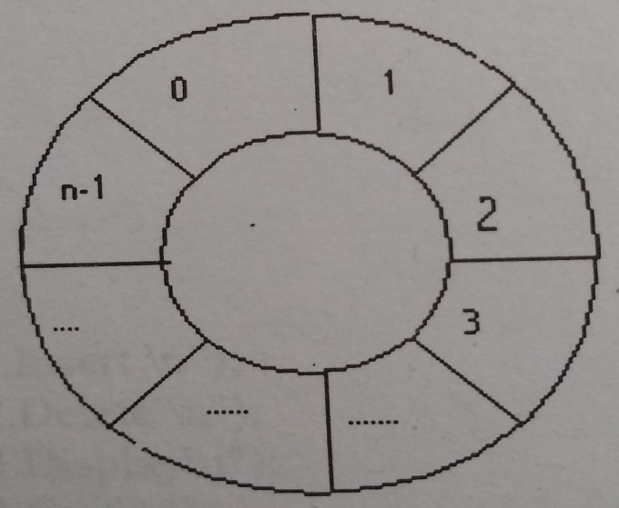
Circular Queue
As in a circle, after last element, first element occurs
Similarly we assume that after last element of queue, the 1st element will occur
After n-1the element, 0th element occurs.

Slide 43
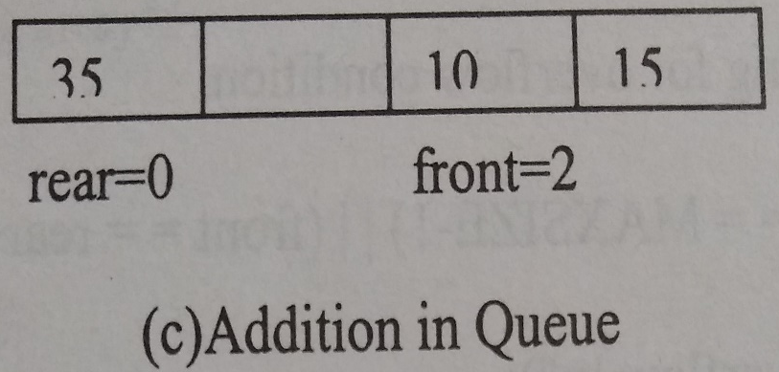
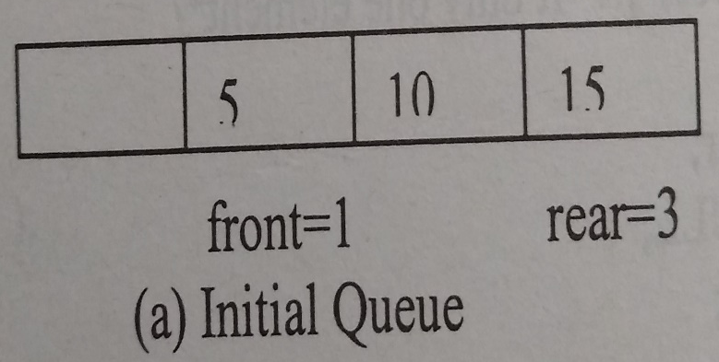
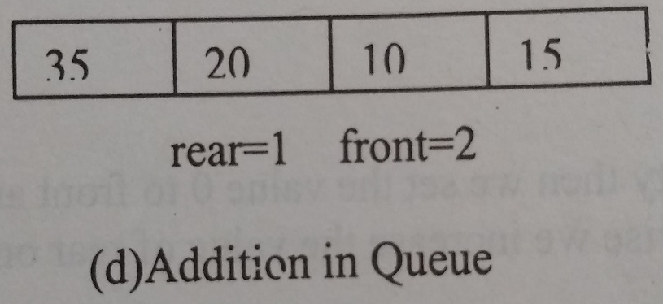

Working of Circular Queue

Slide 44
Working of Circular Queue

Slide 45
Working of Circular Queue
CIRCULAR EFFECT
Rear comes and stands just behind front
??

Slide 46
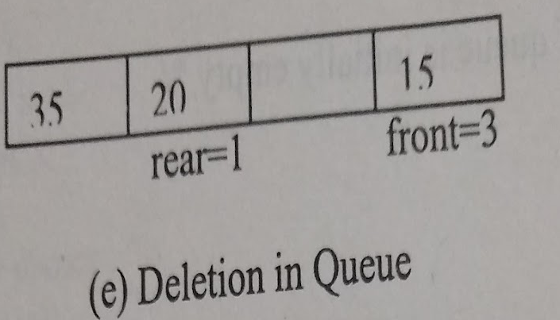

Working of Circular Queue
CIRCULAR EFFECT

Slide 47
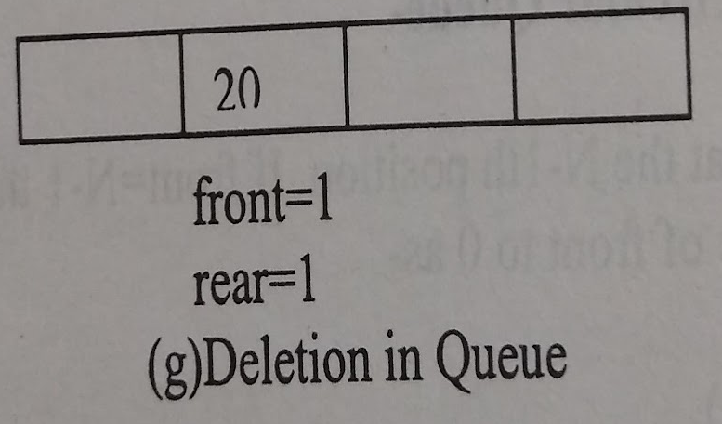
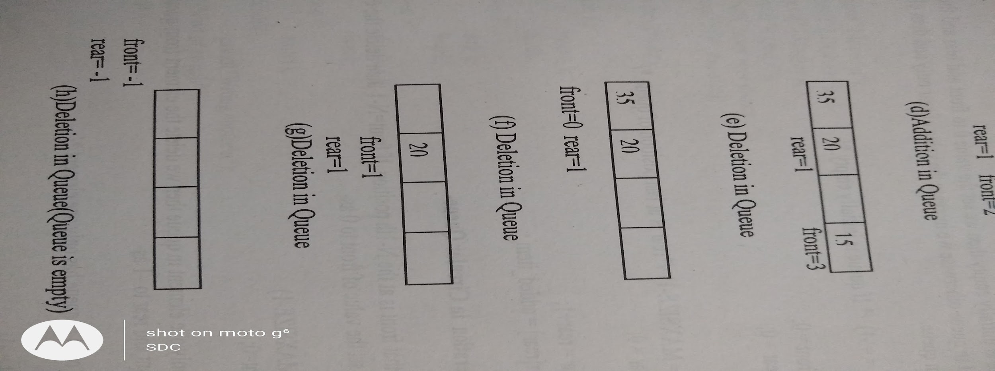
Working of Circular Queue

Slide 48
Circular Queue Implementation using Arrays
# define MAX 5
int cqueue_arr[MAX];
int front = -1;
int rear = -1;

Slide 49
Insert Operation In Circular Queue

Slide 50
Overflow Condition in Circular Queue
If Front=Rear + 1 CIRCULAR EFFECT
Or
IF Front =0 and Rear=Maxsize-1

Slide 51
Overflow Condition in Circular Queue
if((front == 0 && rear == MAX-1) || (front == rear+1))
{
printf("Queue Overflow \n");
return;
}

Slide 52
Add operation in Circular Queue
If Queue is initially empty,
Then we set front =0 and rear =0
Then add the element in the queue
Otherwise
we increase the values of rear only and
then the element will be added in queue

Slide 53
Add operation in Circular Queue/Circular Effect
If Rear=N-1, then we set the values of Rear =0
add the element at the 0th position of the array
otherwise element will be added
same as in simple queue

Slide 54
Insert Operation
insert()
{
int added_item;
if((front == 0 && rear == MAX-1) || (front == rear+1))
{
printf("Queue Overflow \n");
return;
}
if (front == -1) /*If queue is empty */
{
front = 0;
rear = 0;
}
else
if(rear == MAX-1)/*rear is at last position of queue */
rear = 0;
else
rear = rear+1;
printf("Input the element for insertion in queue : ");
scanf("%d", &added_item);
cqueue_arr[rear] = added_item ;
}/*End of insert()*/

Slide 55
Delete Operation In Circular Queue

Slide 56
Underflow Condition in Circular Queue
If Front=-1
Queue is empty

Slide 57
Delete operation in Circular Queue/Circular Effect
If Front=N-1, then
we delete the element and
set the values of Front =0
otherwise element will be deleted
same as in simple queue

Slide 58
If there is only One element in Circular Queue
Whenever front and rear are equal and value is other than -1,
It means only one element if left in the Queue,
So , On deletion, the Queue becomes empty,
Thus Both Front and Rear become -1

Slide 59
Delete Operation
del()
{
if (front == -1)
{
printf("Queue Underflow\n");
return ;
}
printf("Element deleted from queue is : %d\n",cqueue_arr[front]);
if(front == rear) /* queue has only one element */
{
front = -1;
rear=-1;
}
else
if(front == MAX-1)
front = 0;
else
front = front+1;
}/*End of del() */

Slide 60
Display Operation In Circular Queue

Slide 61
Display operation in Circular Queue
Case 1:
First check Queue Underflow condition i.e. Queue is empty-
int front_pos = front,rear_pos = rear;
if(front == -1)
{
printf("Queue is empty\n");
return;
}

Slide 62
Display operation in Circular Queue
Case 2:
printf("Queue elements :\n");
if( front_pos <= rear_pos )
while(front_pos <= rear_pos)
{
printf("%d ",cqueue_arr[front_pos]);
front_pos++;
}

Slide 63
Display operation in Circular Queue
Case 3:
else
{
while(front_pos <= MAX-1)
{
printf("%d ",cqueue_arr[front_pos]);
front_pos++;
}
front_pos = 0;
while(front_pos <= rear_pos)
{
printf("%d ",cqueue_arr[front_pos]);
front_pos++;
}
}/*End of else */

Slide 64
Double ended Queue

Slide 65
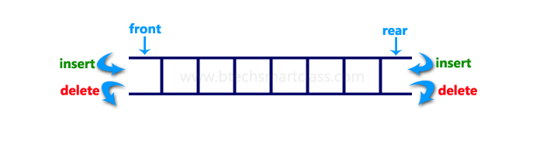
Double ended Queue
Dequeue
Double Ended Queue
We can add or delete the element from both sides.

Slide 66
Double ended Queue
Dequeue can be of 2 types-
Input Restricted
Output restricted

Slide 67
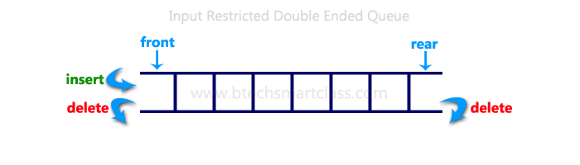
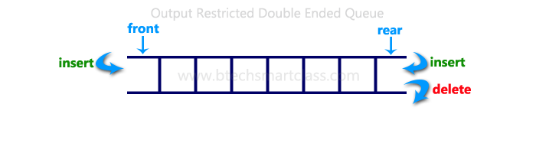
Double ended Queue
Input Restricted Dequeue-
Element can be added at only one end but element can be deleted from both sides.
Output restricted Dequeue
Element can be added from both sides but deletion is allowed only at one end

Slide 68
Double ended Queue
Dequeue can be of 2 types-
Input Restricted-
Right Input Restricted
Left Input Restricted
Output restricted
Right Output Restricted
Left Output Restricted

Slide 69
Double ended Queue
Two Pointer needed-
Left
Right
Left –indicates the left position of the queue
Right –indicates the right position of the queue

Slide 70
Working of Dequeue
We assume Circular array for addition and deletion operations
Lets take an Right Input restricted Dequeue
We can add element only on the right side of the queue but
We can delete from both sides

Slide 71
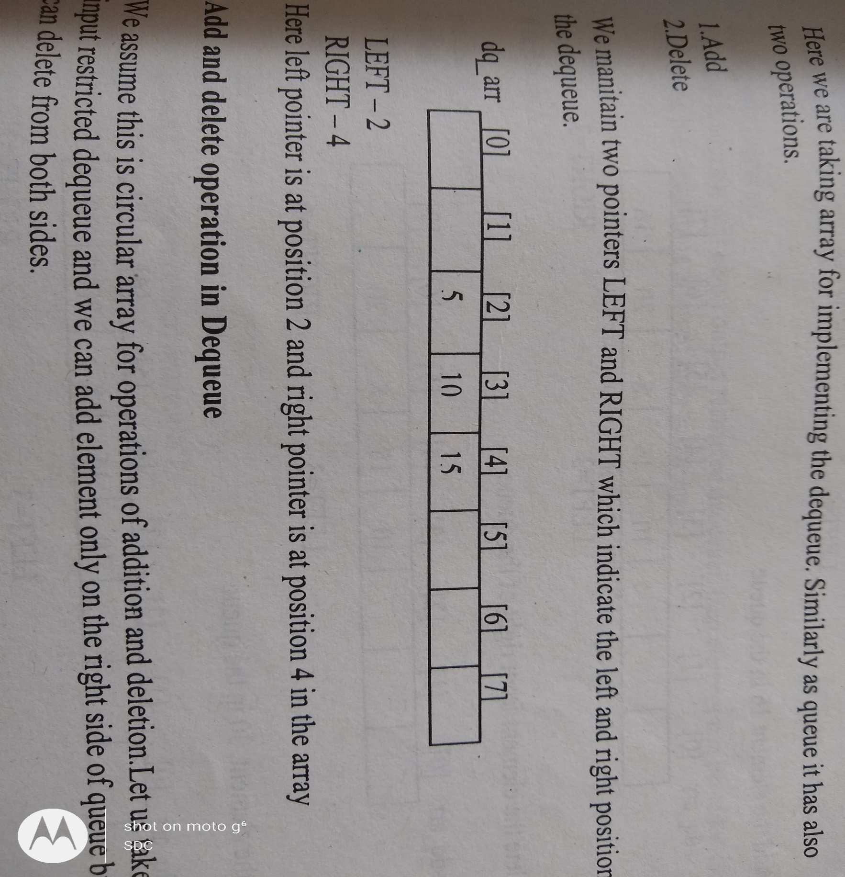
Double ended Queue
Example of Queue

Slide 72
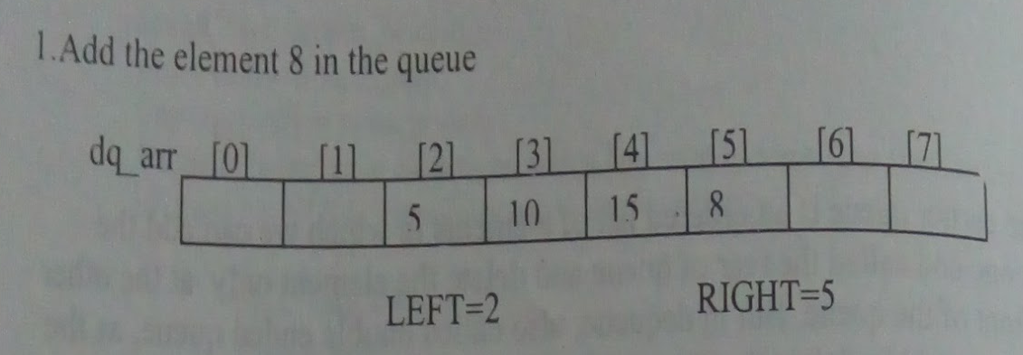

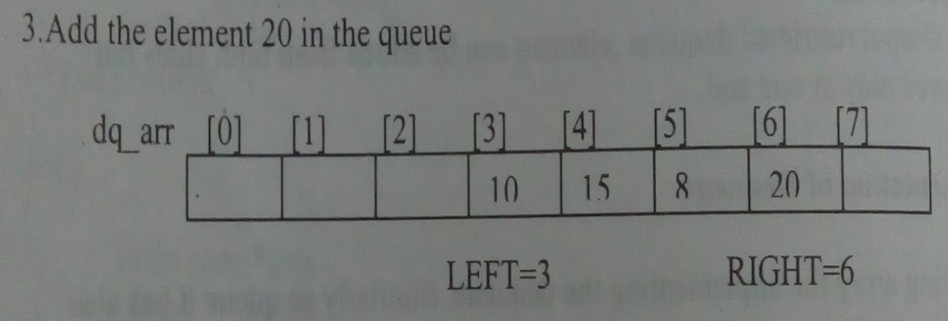
Working of Dequeue
Right=Right+1
Add element at Right
Delete element from Left
Left=Left+1
Right=Right+1
Add element at Right

Slide 73

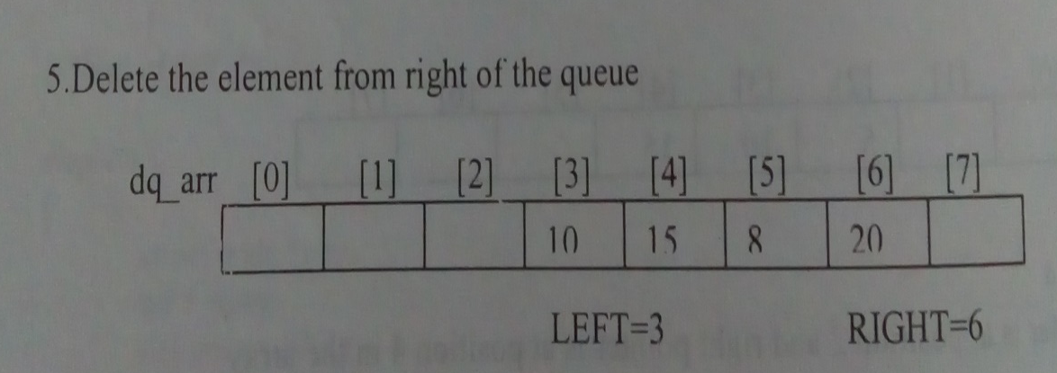
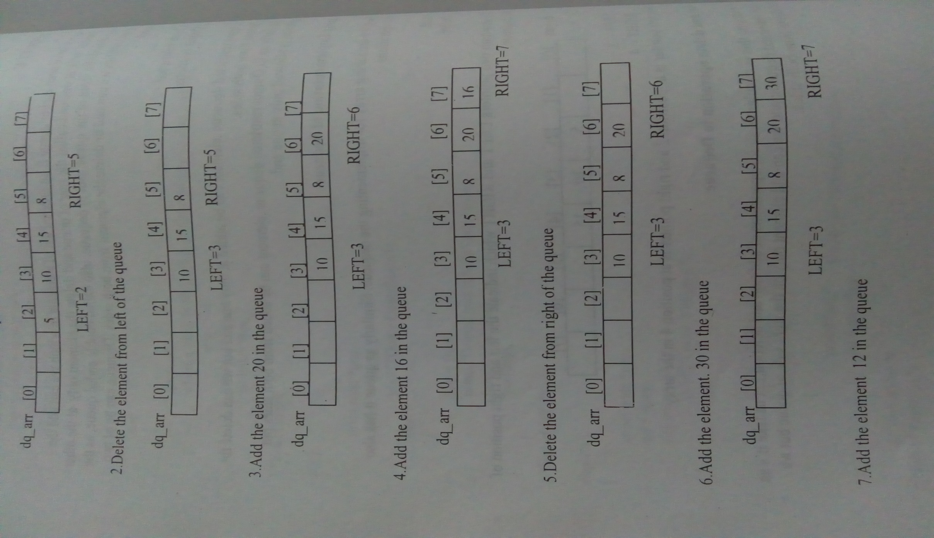
Working of Dequeue
Right=Right+1
Add element at Right
Delete element from Right
Right=Right-1
Right=Right+1
Add element at Right

Slide 74
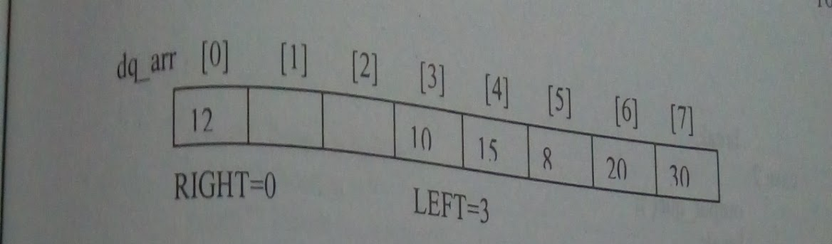


Working of Dequeue
Right=MAX-1
So Right=0
Add element at Right
Right=Right+1
Add element at Right
Right=Right+1
Add element at Right

Slide 75

Insert Operation
To check if Queue is Full-
if((left == 0 && right == MAX-1) || (left == right+1))
{
printf("Queue Overflow\n");
return;
}

Slide 76
Insert Operation
If initially Queue is empty, then both the pointers are incremented
if (left == -1) /* if queue is initially empty */
{
left = 0;
right = 0;
}

Slide 77

Insert Right Operation/Circular Effect-
If right == MAX-1 , then we set the values of right =0
add the element at the 0th position of the array

Slide 78
Insert Right Operation/Circular Effect-
otherwise element will be added
same as in simple queue, right=right+1

Slide 79
Insert Right Operation
insert_right()
{
int added_item;
if((left == 0 && right == MAX-1) || (left == right+1))
{
printf("Queue Overflow\n");
return;
}
if (left == -1) /* if queue is initially empty */
{
left = 0;
right = 0;
}
else
if(right == MAX-1) /*right is at last position of queue */
right = 0;
else
right = right+1;
printf("Input the element for adding in queue : ");
scanf("%d", &added_item);
deque_arr[right] = added_item ;
}/*End of insert_right()*/

Slide 80
Insert Left Operation/Circular Effect-
If left == 0 , then we set the values of left =MAX-1
add the element at the MAX-1 th position of the array
otherwise element will be added
same as in left=left-1

Slide 81
Insert Left Operation
insert_left()
{
int added_item;
if((left == 0 && right == MAX-1) || (left == right+1))
{
printf("Queue Overflow \n");
return;
}
if (left == -1)/*If queue is initially empty*/
{
left = 0;
right = 0;
}
else
if(left== 0)
left=MAX-1;
else
left=left-1;
printf("Input the element for adding in queue : ");
scanf("%d", &added_item);
deque_arr[left] = added_item ;
}/*End of insert_left()*/

Slide 82
Delete Operation
To check if Queue is Empty-
if (left == -1)
{
printf("Queue Underflow\n");
return ;
}

Slide 83

Delete Operation
To check if Queue has only one element-
Left=2
Right=4
Delete at Left
Left=Left+1
Left=3
Right=4
[0] | [1] | [2] | [3] | [4] | [5] | [6] | [7]
 |  |  | 10 | 15
L
R
[0] | [1] | [2] | [3] | [4] | [5] | [6] | [7]
 |  |  | 10
Delete at Right Left=3
Right=3
Right=Right-1
L
R
Left == Right

Slide 84
Delete Operation
To check if Queue has only one element-
if(left == right) /*queue has only one element*/
{
left = -1;
right=-1;
}

Slide 85
Delete Left Operation/Circular Effect-
If left == MAX-1 , then
Delete the element and
Set the values of left =0
otherwise element will be deleted
And left=left+1

Slide 86
Delete Left Operation
delete_left()
{
if (left == -1)
{
printf("Queue Underflow\n");
return ;
}
printf("Element deleted from queue is : %d\n",deque_arr[left]);
if(left == right) /*Queue has only one element */
{
left = -1;
right=-1;
}
else
if(left == MAX-1)
left = 0;
else
left = left+1;
}/*End of delete_left()*/

Slide 87
Delete Right Operation/Circular Effect-
If right == 0 , then
Delete the element and
Set the values of right =MAX-1
otherwise element will be deleted
And right=right-1

Slide 88
Delete Right Operation
delete_right()
{
if (left == -1)
{
printf("Queue Underflow\n");
return ;
}
printf("Element deleted from queue is : %d\n",deque_arr[right]);
if(left == right) /*queue has only one element*/
{
left = -1;
right=-1;
}
else
if(right == 0)
right=MAX-1;
else
right=right-1;
}/*End of delete_right() */

Slide 89
Display Operation/Circular Effect-
Same as Circular Queue

Slide 90
Display Operation
display_queue()
{
int front_pos = left,rear_pos = right;
if(left == -1)
{
printf("Queue is empty\n");
return;
}
printf("Queue elements :\n");
if( front_pos <= rear_pos )
{
while(front_pos <= rear_pos)
{
printf("%d ",deque_arr[front_pos]);
front_pos++;
}
}
else
{
while(front_pos <= MAX-1)
{
printf("%d ",deque_arr[front_pos]);
front_pos++;
}
front_pos = 0;
while(front_pos <= rear_pos)
{
printf("%d ",deque_arr[front_pos]);
front_pos++;
}
}/*End of else */
printf("\n");
}/*End of display_queue() */

Slide 91
Priority Queue

Slide 92
Priority Queue
A priority queue is a data structure used for storing a set S of elements, based on a key value, which denotes the priority of that element.

Slide 93
Priority Queue
The priority determines the order in which they exit the queue.
Every element of queue has some priority and based on that priority it will be processed.

Slide 94
Priority Queue
Element of higher priority will be processed/removed before the element that has low priority
With 2 elements of same priority, FIFO rule will be the tie breaker
The element that comes first in the queue , will be processed first.

Slide 95
Priority Queue
Generally
Smaller Numbers => Higher Priorities
Bigger Numbers =>Lower Priority

Slide 96
Priority Queue
In computer implementation, Priority Queue is used In CPU scheduling algorithm.
Processes with Higher priority are allocated the CPU first.

Slide 97
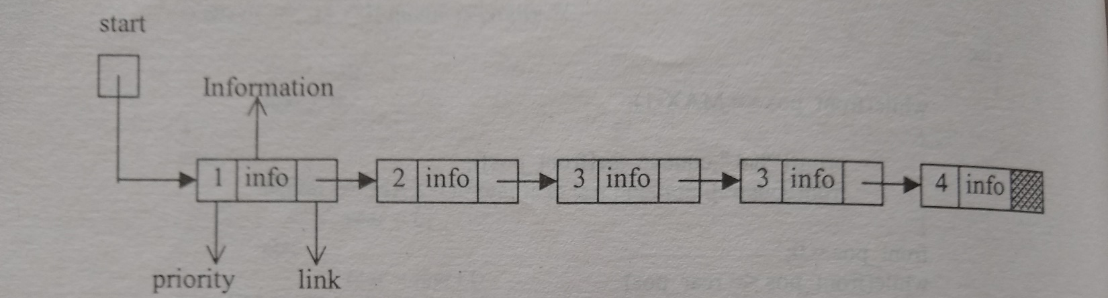
Linked List Implementation of Priority Queue
Structure of Linked List-
struct pq{
int priority;
int data;
struct pq *link;
}

Slide 98
Operations in Priority Queue
Similar to other Queues, Priority Queues also have :
Add Operation
Deletion Operation

Slide 99
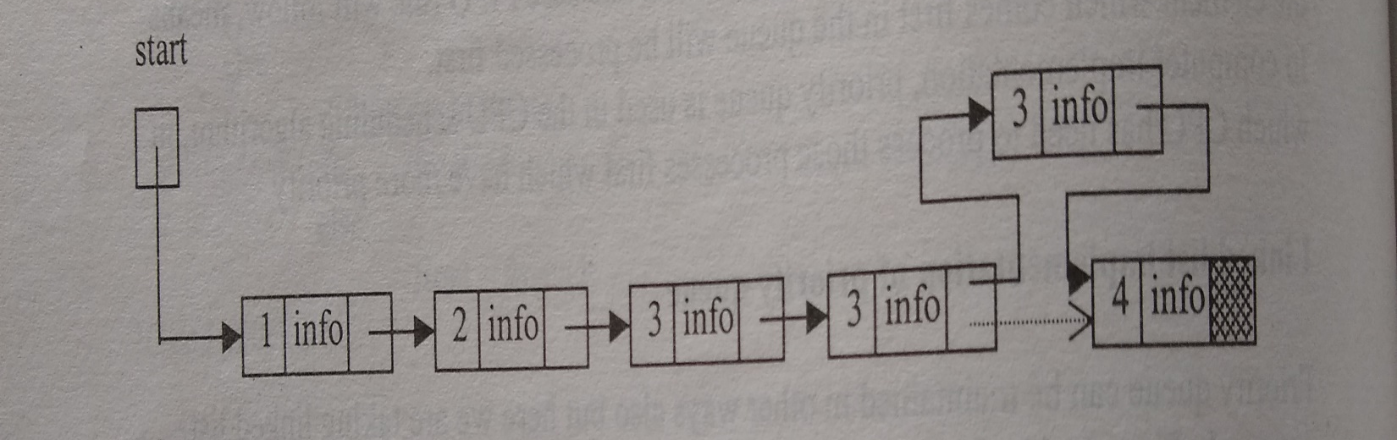
Add Operation in Priority Queue
Same as Insertion in Sorted Linked List
Insert the new element on the basis of priority of element
The new element will be inserted before the element which has less priority than new element

Slide 100
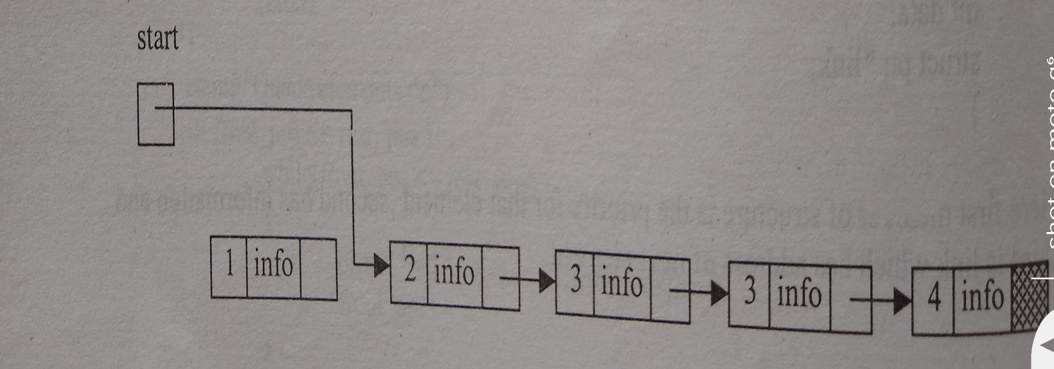
Deletion Operation in Priority Queue
Deletion of First element of the linked list because it has more priority than other elements of Queue

Slide 101
Applications of Priority Queue
1) CPU Scheduling
2) Graph algorithms like Dijkstra’s shortest path algorithm, Prim’s Minimum Spanning Tree, etc
3) All queue applications where priority is involved.

Slide 102
GATE | GATE-CS-2016 (Set 1) | Question 20
A queue is implemented using an array such that ENQUEUE and DEQUEUE operations are performed efficiently. Which one of the following statements is CORRECT (n refers to the number of items in the queue)?
(A) Both operations can be performed in O(1) time (B) At most one operation can be performed in O(1) time but the worst case time for the other operation will be Ω(n) (C) The worst case time complexity for both operations will be Ω(n) (D) Worst case time complexity for both operations will be Ω(log n)

Slide 103
GATE | GATE-CS-2016 (Set 1) | Question 20
A queue is implemented using an array such that ENQUEUE and DEQUEUE operations are performed efficiently. Which one of the following statements is CORRECT (n refers to the number of items in the queue)?
(A) Both operations can be performed in O(1) time (B) At most one operation can be performed in O(1) time but the worst case time for the other operation will be Ω(n) (C) The worst case time complexity for both operations will be Ω(n) (D) Worst case time complexity for both operations will be Ω(log n) Answer: (A)

